Slide 1
Possibilities of IoT Based Blood Pressure Health Monitoring System
By:- SHALOMSHAN
CSD Batch:- 08

Slide 2
Table of Content
Objective
Reason for Choosing This Research Project
Methodology
Approach
Data Collection
Conclusion

Slide 3
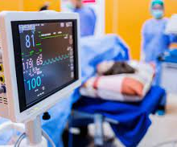
Objective
The purpose of this research is to provide a solution to this by using IoT, which is now found in the computer technology of the modern world, to prevent deaths due to nurse & doctor negligence in hospitals.

Slide 4
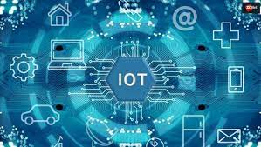
Reason for Choosing This Research Project
If I chose this topic I am studying Computer science specialized in software engineering at BCAS Campus. The title published by Pearson in my academic year 2021 is IoT which is why I have chosen IoT as the research & project title based on the research & project I have to do this year.

Slide 5


Methodology
This research requires the use of quantitative aspects are incorporated to reach the expected outcome. The psychological aspects are treated and analyzed by means of quantitative approach whereas machine learning involves quantitative approach such as statistical computation.

Slide 6

Approach
This research employs deductive approach to select the most efficient algorithm by comparing the existing theories, algorithms and tools & technologies available.

Slide 7

Data Collection
Questionnaires
Questionnaire as an instrument for collecting data, which almost always involves asking a given subject to respond to a set of oral or written questions.
Inexpensive
Easy analysis
Fast result
Validity & Reliability
Comparability

Slide 8
Conclusion
The conclusion reiterates the importance or significance of my proposal and provides a brief summary of the entire study. This section should be explained five section.
Someone reading this section should come away with an understanding of:
Research Objective
Reason for Choosing This Research Project
Research Methodology
Research Approach
Data Collection Methods

Slide 9

THANK YOU

